Slide 1
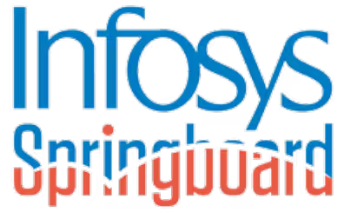
Smart Crowd Monitoring & Alert System
AI-powered Real-time Detection, Tracking, and Analytics
Tools Used: Flask, YOLO v8, OpenCV, PostgreSQL, ReportLab, JWT
By: Tushar Dayma
Mentor_5: Umme Asma
Batch Details:
Training Start Date: 22th September 2025
Training End Date _ 21-November 2025

Slide 2
Table of Contents
Introduction – Overview of the project and its purpose.
Problem Statement – Challenges in manual crowd monitoring.
Objectives – Goals of developing an AI-powered solution.
System Architecture – Workflow from detection to alert generation.
Technology Stack – Tools and frameworks used in the system.
Core Components – Flask app, YOLO v8 detector, and database modules.
Detection & Tracking – Real-time person tracking and zone monitoring.
Database Design – Data storage and relationships for users and alerts.
Dashboard & Reports – Real-time analytics and PDF/CSV reporting.
Admin Panel – Role management and threshold configuration.
Applications – Real-world use cases across various domains.
Future Enhancements – Planned improvements and scalability ideas.
Conclusion – Summary and key takeaways.

Slide 3
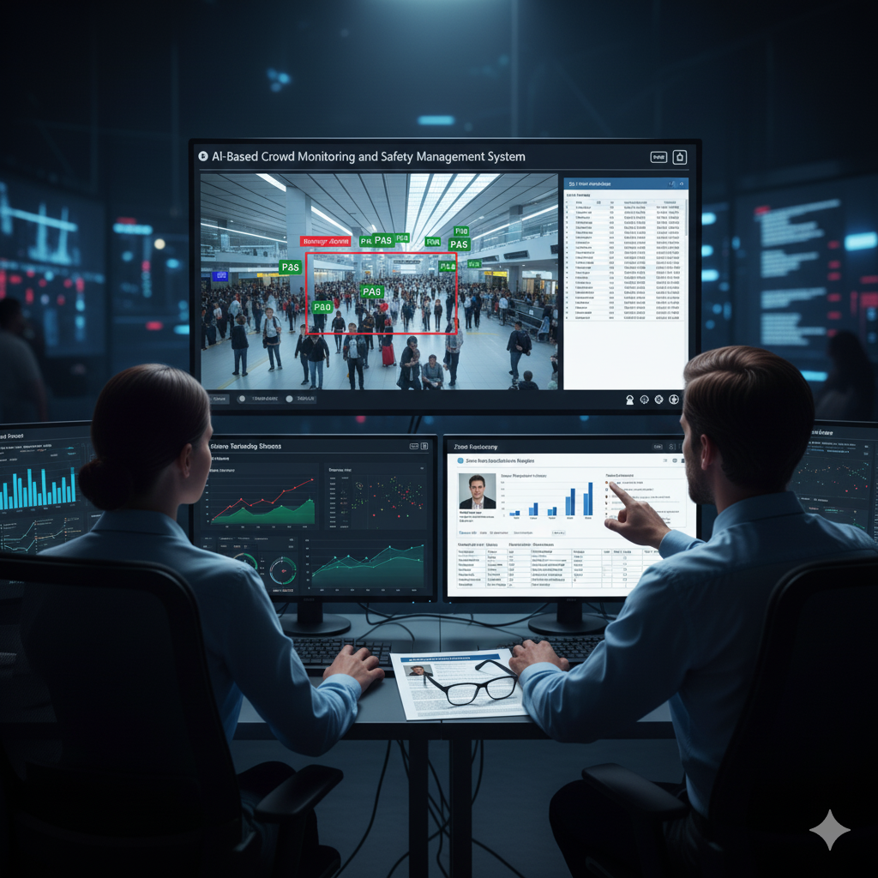
Introduction
This project is an AI-Based Crowd Monitoring and Safety Management System designed to automate real-time people counting and monitoring. It addresses the inefficiencies of manual supervision by using a Flask-based application and YOLOv 8 to detect and track individuals in video feeds. The system automatically monitors time spent in user-defined "Danger Zones," triggers alerts for overcrowding, and features a secure, role-based login system with a live analytics dashboard and a full admin panel for system configuration.

Slide 4
Problem Statement
Traditional crowd monitoring in public spaces like malls, airports, and parks relies heavily on human supervision, which is often inefficient, prone to delays, and subject to human error. This manual approach makes it difficult to gather accurate, real-time data for security, operational efficiency, and analytics.
There is a need for an automated system that can:
Detect, track, and count people in real-time.
Monitor specific, user-defined "Danger Zones" or "Restricted Areas".
Automatically trigger configurable alerts for threshold breaches, such as overcrowding or individuals loitering too long in a danger zone.
Provide live analytics and exportable reports to improve safety and decision-making.

Slide 5
Objectives
Automate Detection and Tracking: To detect and track each individual in a live or recorded video feed using computer vision.
Implement Zone Monitoring: To allow users to define a "Danger Zone" and monitor the precise amount of time each person spends within it.
Develop a Real-time Alert System: To automatically trigger and log configurable alerts when thresholds are breached, such as a person loitering too long, zone overcrowding, or overall high population.
Provide Live Data Visualization: To create an interactive dashboard that displays real-time analytics, including live counts, population-over-time charts, and zone statistics.
Enable Admin Control: To build a secure, role-based admin panel that allows for user management and the customization of system-wide alert settings.
Generate Reports: To provide exportable PDF and CSV reports for detailed analysis of individual activity and historical alert data.

Slide 6
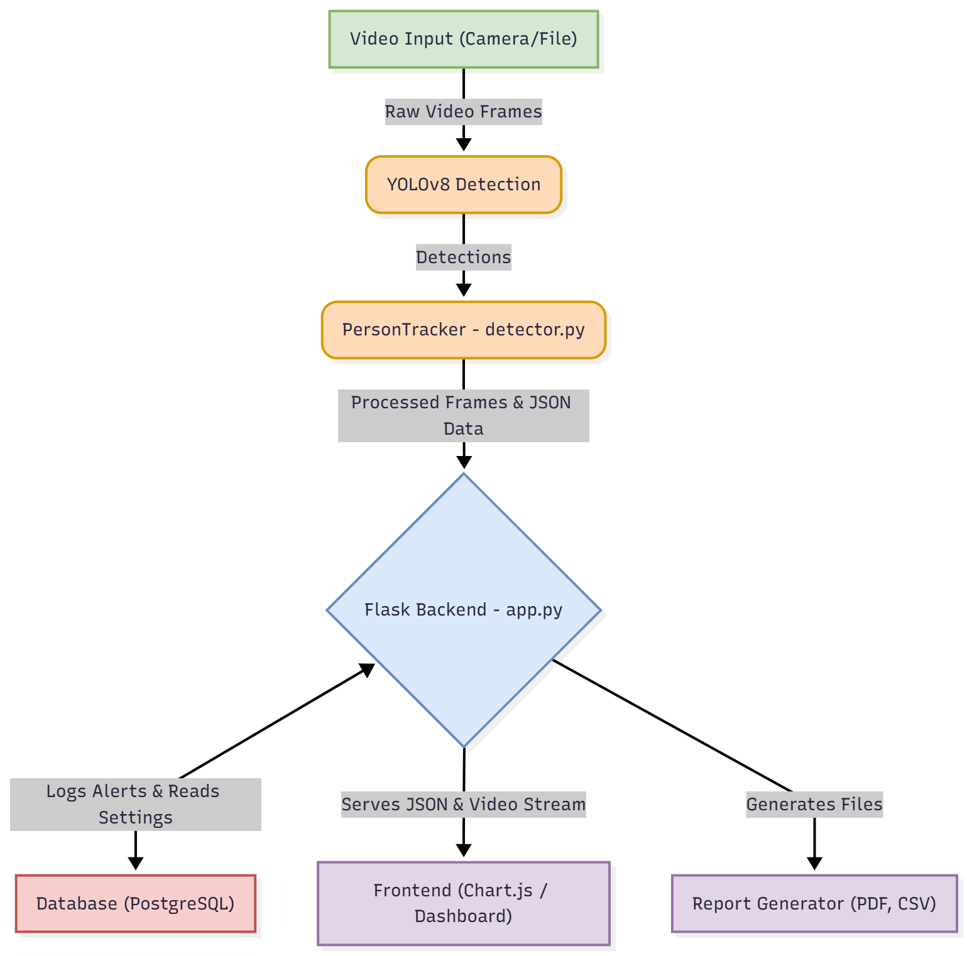
System Architecture

Slide 7
Technology Stack
Component | Technology | Purpose in This Project
Backend Framework | Flask | The core web server handling routes, logic, and serving data.
AI Detection | YOLO v8 (Ultraltics) | Real-time object detection model used to find people in video frames.
Video Processing | OpenCV-Python | Used for capturing video, processing frames, drawing zones, and generating the live stream.
Database | PostgreSQL | The relational database used to store all persistent data (users, alerts, settings).
Database ORM | Flask-SQLAlchemy | Manages the database schema and handles all database queries in Python.
Authentication | Flask-JWT-Extended | Manages user sessions using JWT (JSON Web Tokens) for secure login and role-based access.
Frontend Logic | JavaScript (AJAX/Fetch) | Asynchronously fetches data from the backend to update the dashboard live without a page reload.
Data Visualization | Chart.js | A JavaScript library used to create the live charts on the dashboard and admin panel.

Slide 8
Component | Technology | Purpose in This Project
AI Tracking | ByteTrack / BoT-SORT | The algorithm used by YOLOv 8 to assign and maintain unique IDs for each person.
DB Connector | psycopg2-binary | The Python driver that allows Flask/SQLAlchemy to communicate with the PostgreSQL database.
Password Security | Werkzeug Security | A Flask dependency used to securely hash user passwords and verify them during login.
Frontend Display | HTML / CSS | Provides the structure and styling for all web pages.
PDF Reporting | ReportLab | A Python library used to dynamically generate and serve PDF reports for individual person data.
CSV Reporting | CSV (Python Module) | Used within app.py to generate and stream CSV files of user alert histories.
Configuration | python-dotenv | Loads secret keys and database credentials from the .env file into the application.
AI Configuration | PyYAML | Used by detector.py to load AI model settings (like the tracker file) from config.yaml.
Scientific Computing | NumPy | Used in detector.py to perform the mathematical operations for the heatmap overlay.

Slide 9
Core Components
Module (File) | Primary Role | Brief Responsibilities
app.py | Backend Controller | Handles routes, JWT auth, DB operations, APIs, and live stream handling.
detector.py | AI Detection Engine | Runs YOLO v8, tracks people, calculates zone time, checks alerts, creates video overlays.
script.js | User Dashboard Logic | Fetches /person_data, updates live charts, displays alerts & table data.
admin.js | Admin Panel UI | Manages tabs, fetches admin stats, shows “Alerts per User” chart.
report_generator.py | PDF Generator | Creates person-specific PDF reports using ReportLab.

Slide 10
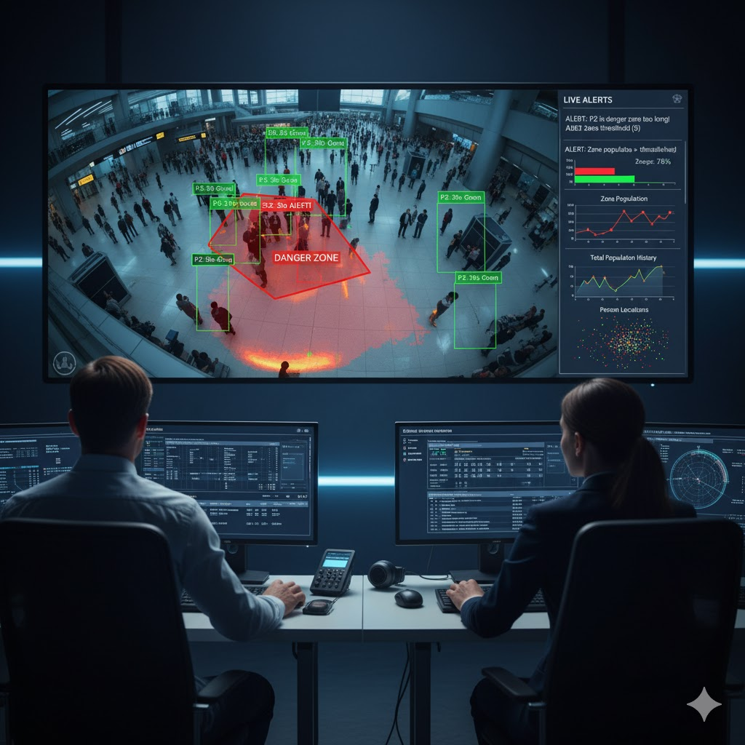
Detection & Tracking
The detector.py file acts as the AI “brain,” handling person detection, tracking, and visualization in the video.
1. Detection
Uses YOLO v8 (yolo v8n.pt) to scan each video frame.
Model is configured to detect only the "person" class.
2. Tracking
Uses a tracker (e.g., ByteTrack from config.yaml) to give each person a unique ID (P1, P2, P3…).
Maintains per-person data (like zone time) in a track_data dictionary.
3. Visualization
Draws bounding boxes: green for safe, red for Danger Zone.
Creates a live heatmap and displays text alerts over the video.

Slide 11
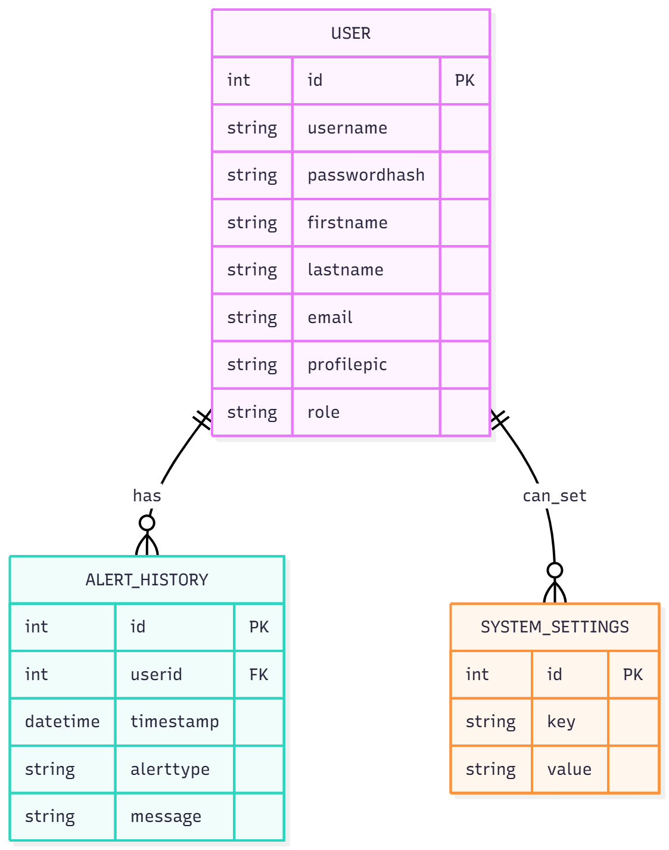
Database Design

Slide 12
Table Name | Purpose | Key Fields & Details
User | Stores all user accounts, authentication details, and access levels. | - id (PK): Unique identifier for each user. - username, password_hash: Secure login credentials. - profile_pic: Path to user’s profile image. - role: Defines access level (user / admin) to control dashboard and admin panel access.
AlertHistory | Maintains a permanent log of all alerts generated by the AI detector. | - id (PK): Unique alert record. - user_id (FK): Links alert to the active user. - timestamp: Exact date & time of alert. - alert_type: Type of alert (Per-Person / Zone / Overall). - message: Full alert description.
SystemSettings | Stores dynamic, editable system-wide settings controlled by admin. | - key: Name of setting (e.g., person_threshold). - value: Current value of the setting. - Advantage: Updates apply instantly; app.py reloads detector without server restart.

Slide 13
Dashboard & Reports
Section | Purpose / Description | Key Features
Live User Dashboard | Real-time monitoring panel updated every second using /person_data API. | - Bar Chart: Zone Population (Red vs Green). - Line Chart: Total population over time. - Scatter Plot: Person positions (x, y), color-coded by zone. - Live alert list. - Detailed person table with zone times & alert status.
Admin Panel Dashboard | Secure dashboard for administrators to manage system data. | - Tabbed interface (Users, Alerts, Settings). - “Alerts Per User” Chart.js bar chart. - Modify system settings and manage accounts.
PDF Reports (Per Person) | Generates individual person summary reports using report_generator.py. | - Uses ReportLab. - Shows person ID, time spent in each zone, final alert summary. - Download available from dashboard.
CSV Reports (Alert History) | Provides complete alert log for review and export. | - Generated in app.py. - Contains Timestamp, Alert Type, Message. - Users download their own history; admins download full history.

Slide 14
Admin Panel
A secure, role-protected dashboard accessible only to admin users. Provides system management, alert oversight, and live configuration through a tabbed interface.
1. User Management
View all registered users with roles and status.
Promote/demote roles (system prevents demoting the last admin).
Delete user accounts (except the last admin).
Download complete CSV alert history for any user.
2. Alert Logs & Statistics
View all system alerts from all users.
Alerts Per User bar chart to identify high-alert users or hotspots.
3. System Settings
Modify AI thresholds live:
Per-Person Threshold
Zone Population Threshold
Overall Population Threshold
Instant Apply: app.py reloads detector immediately—no server restart needed.

Slide 15
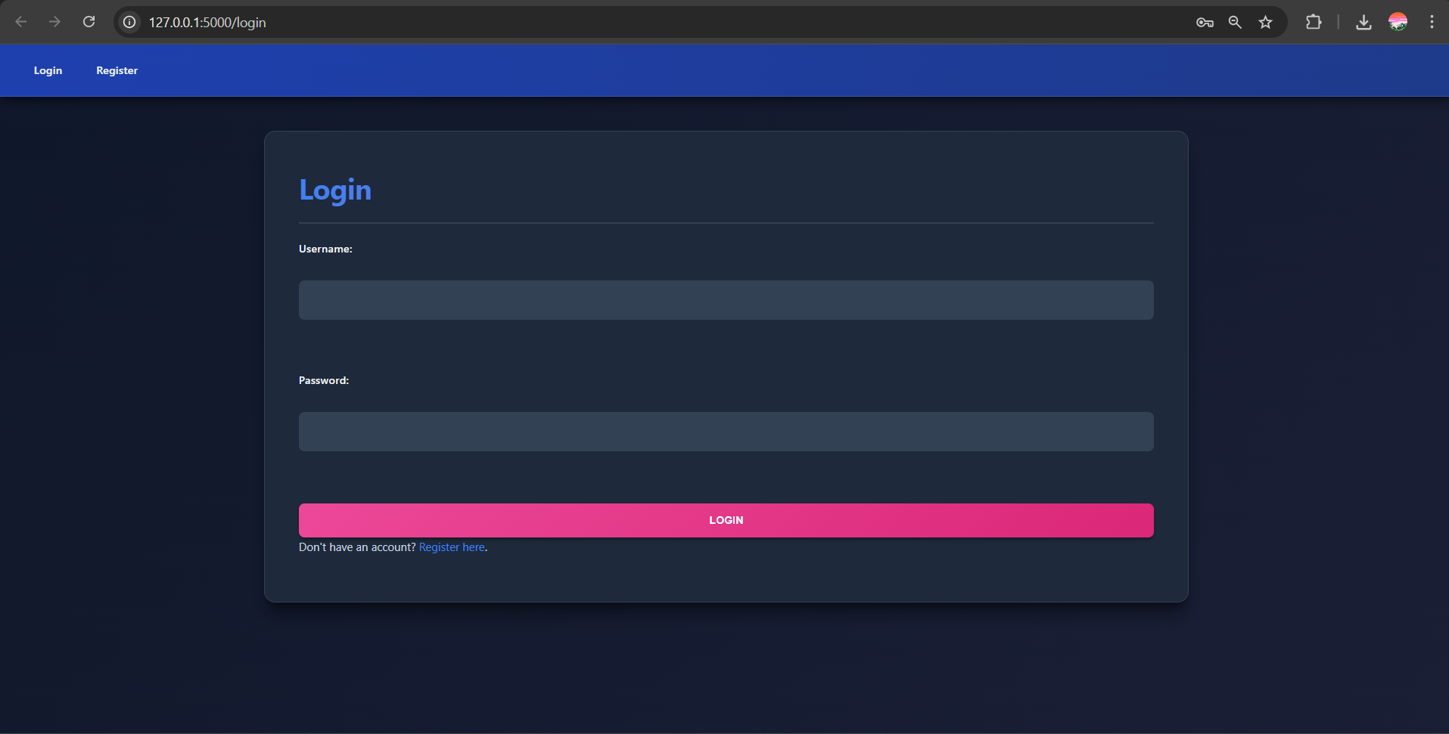
Outputs
login Page

Slide 16
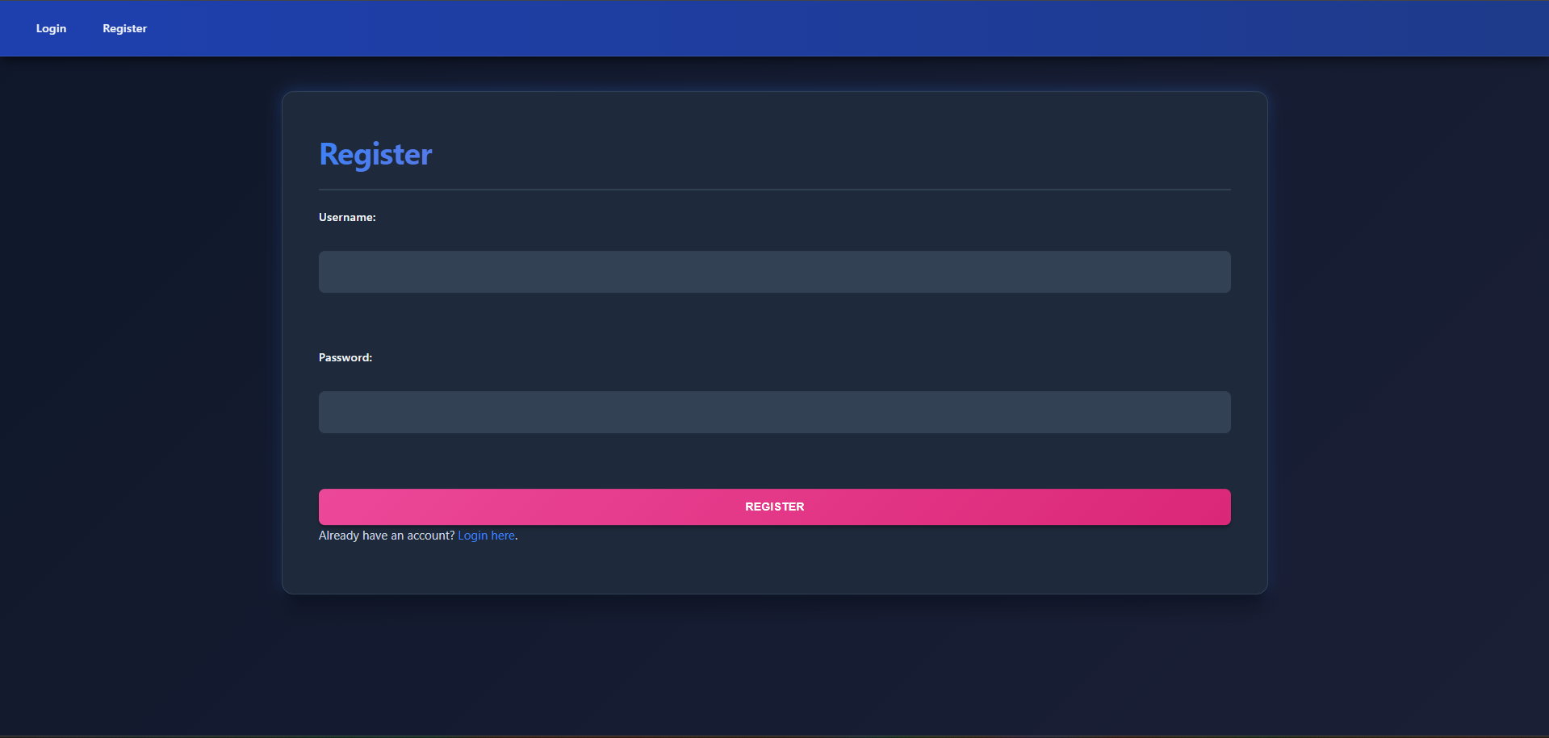
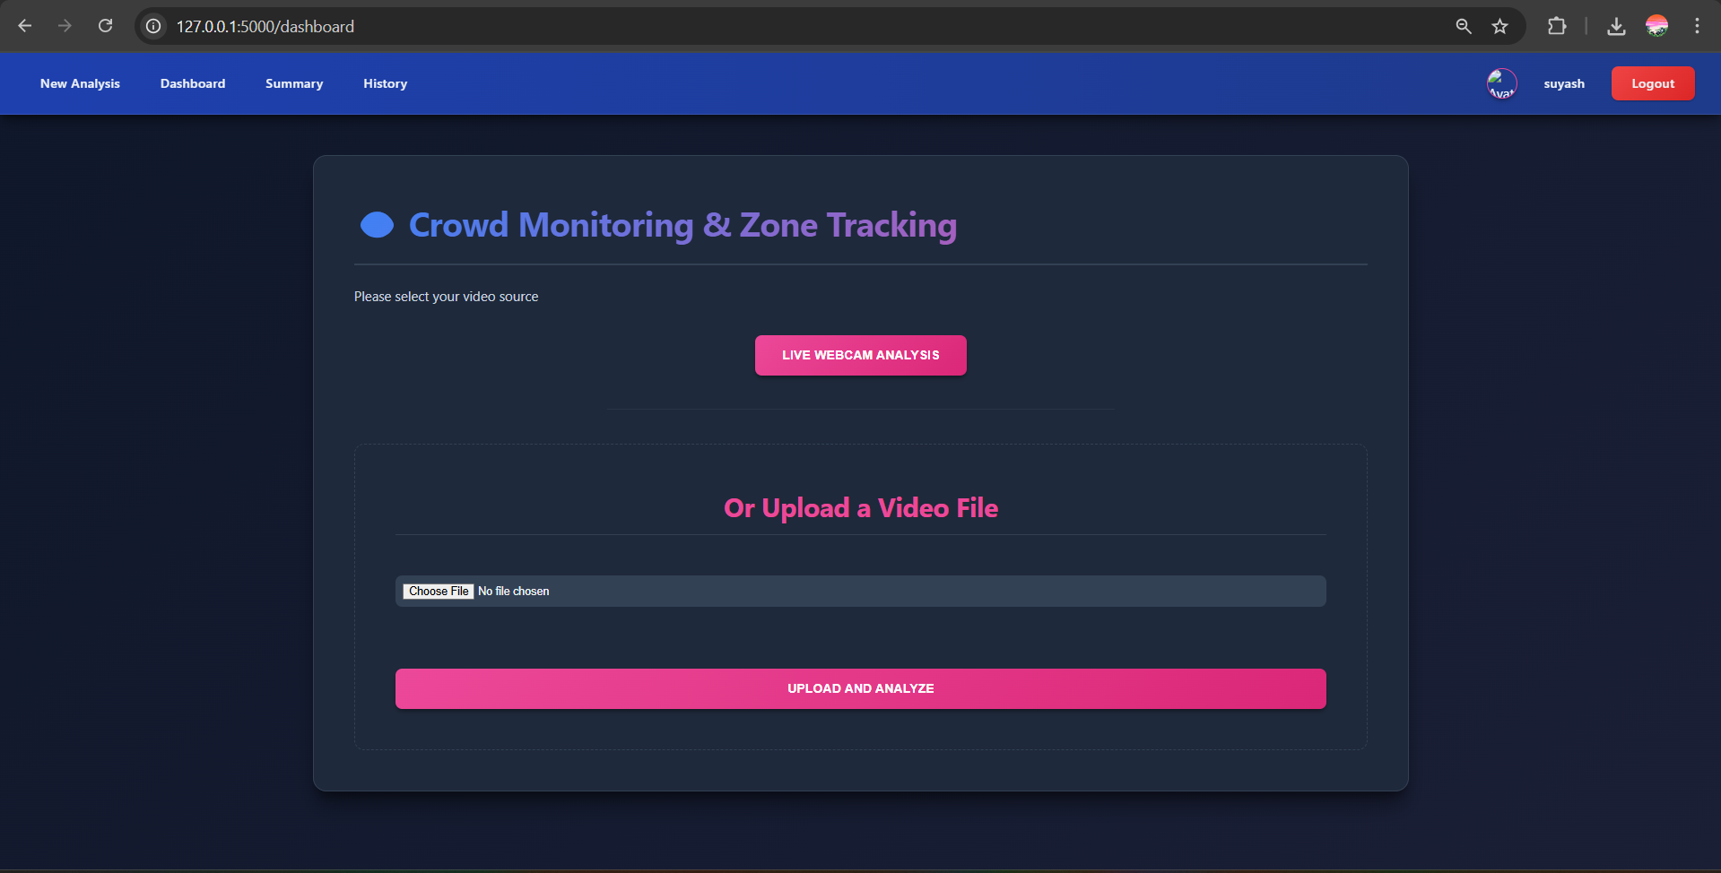
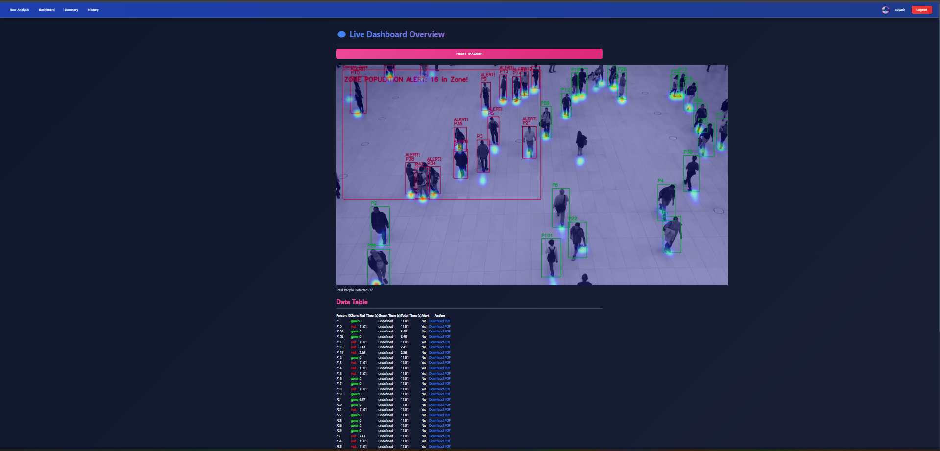
2. Registration Page
3. Analysis Page
3. Dashboard Page

Slide 17
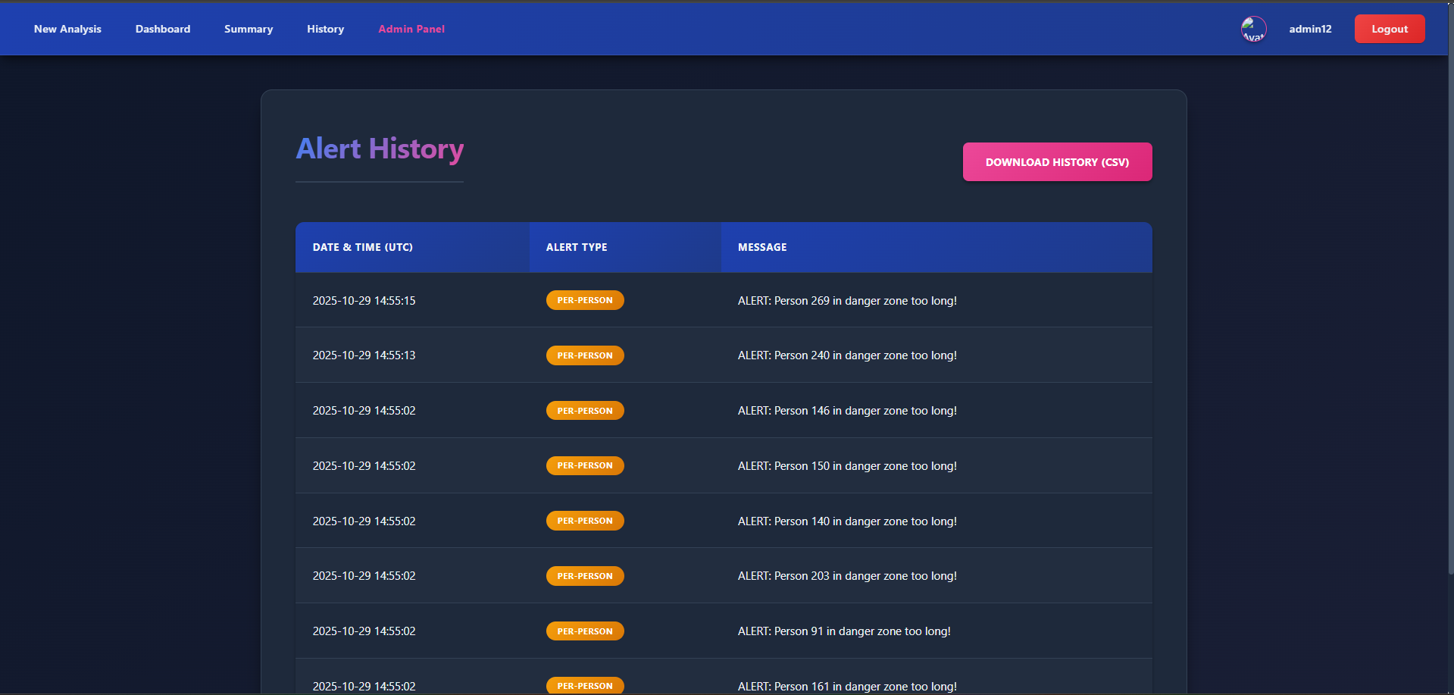
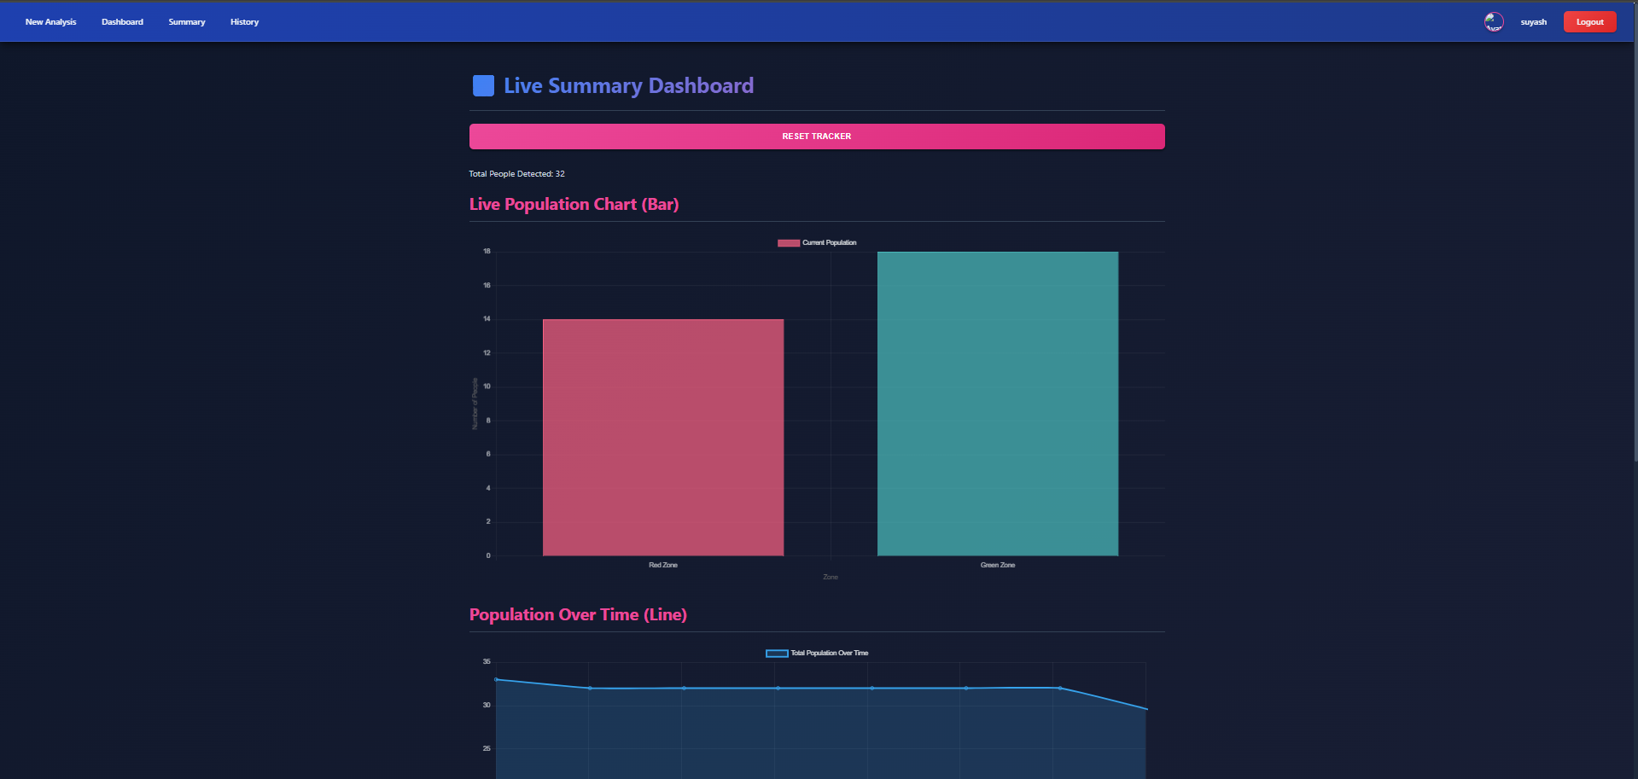
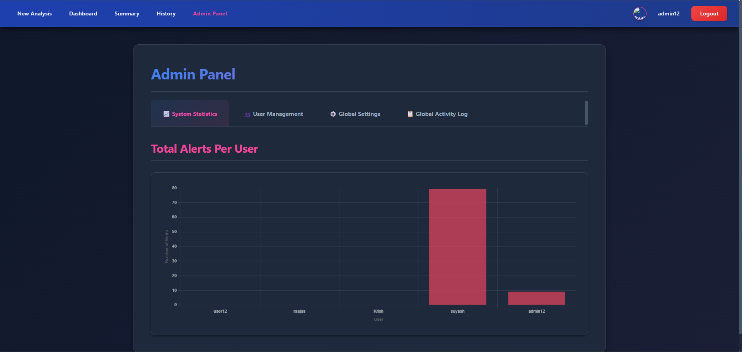
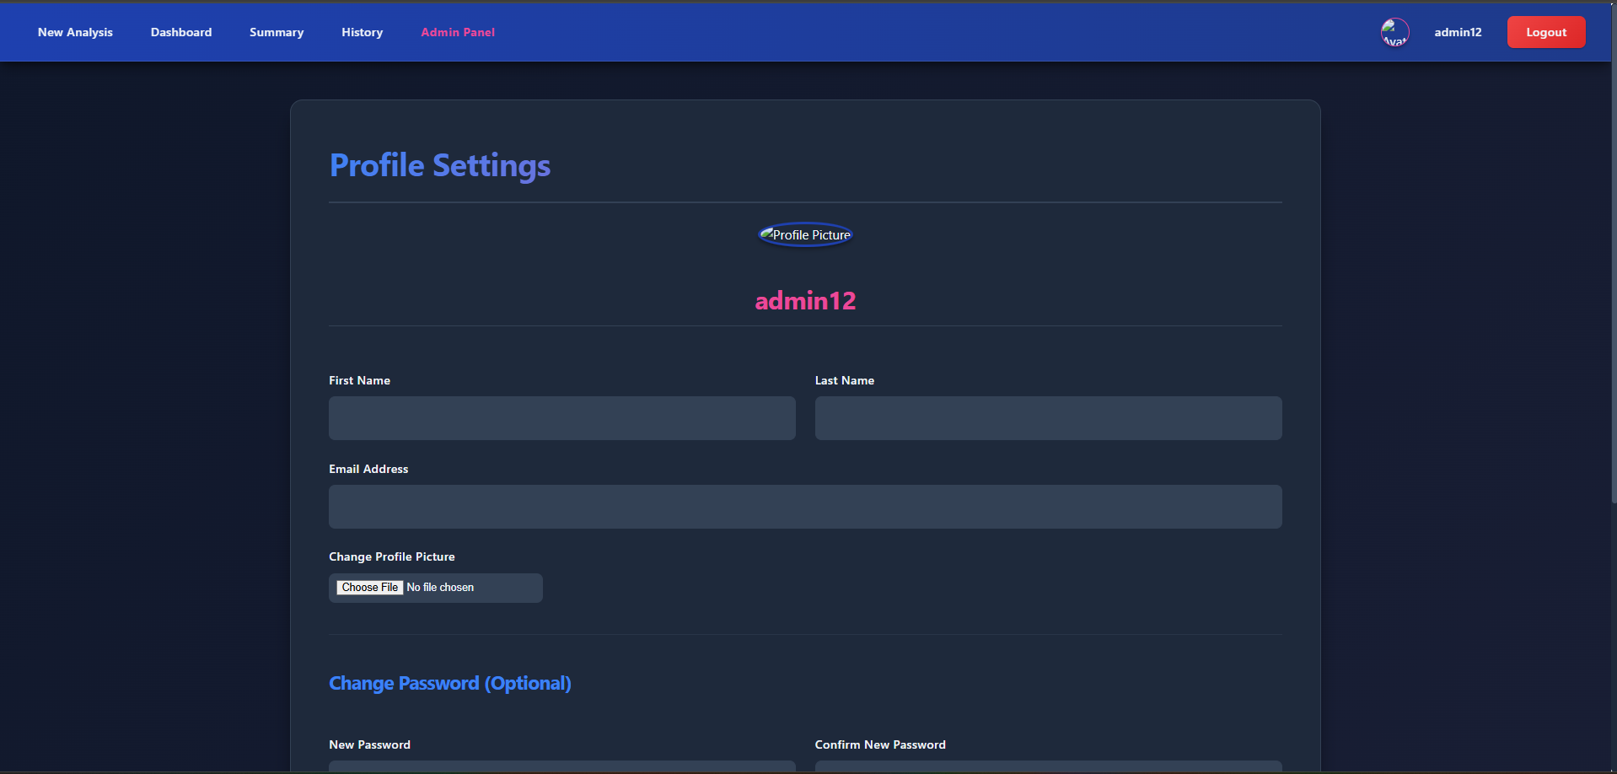
4. Summary Page
5. History Page
6. Admin Panel
7. Profile Page

Slide 18
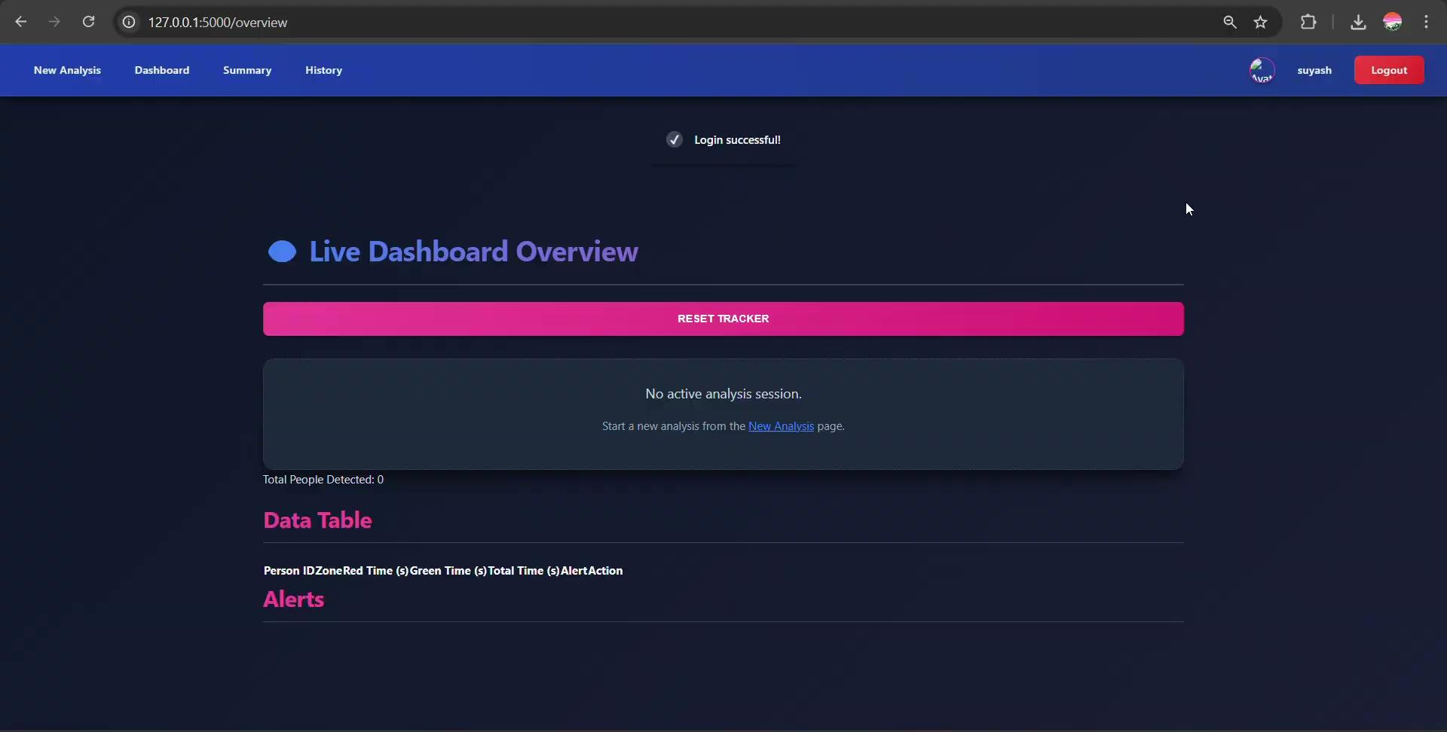
Video Outputs
User Login Demo

Slide 19
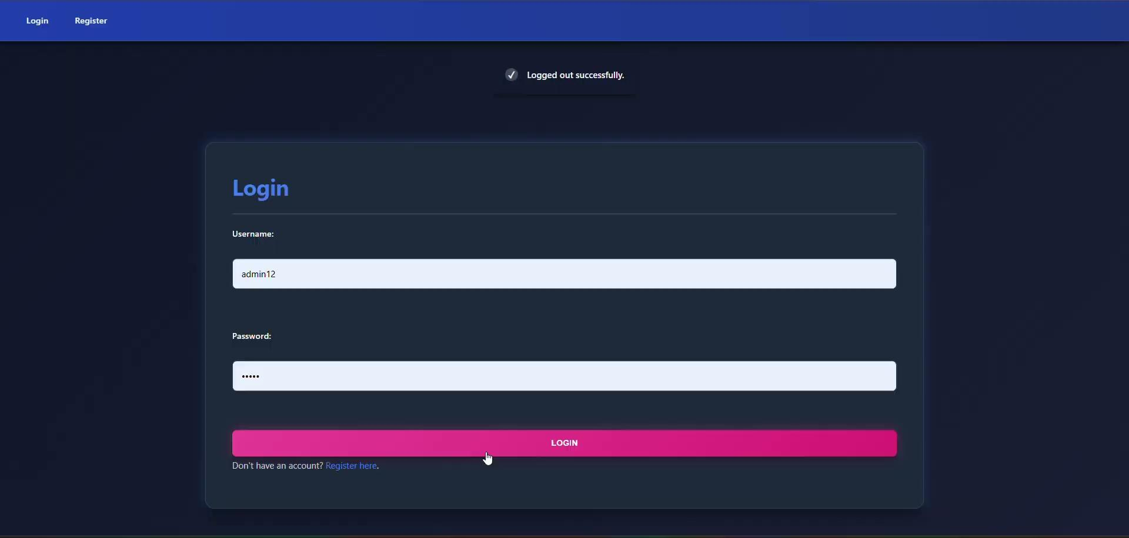
Admin Login Demo

Slide 20
Applications
Category | Where It Is Used | Key Applications (Brief & Informative)
Public Safety & Security | Public areas (malls, airports, stations, parks, stadiums) | - Real-time crowd monitoring for safety. - Automated alerts for overcrowding or restricted-zone entry. - Enhances existing CCTV with intelligent tracking. - Helps security teams respond faster during emergencies.
Operational Efficiency & Analytics | Offices, campuses, transport hubs, events | - Foot-traffic and movement pattern analysis. - Heatmaps for optimizing space layout and navigation paths. - Queue monitoring for better staff allocation. - Exportable reports for long-term planning.
Retail & Business Intelligence | Retail stores, supermarkets, showrooms | - Dwell-time tracking near product displays. - Zone-wise engagement analytics for better store design. - Helps evaluate effectiveness of marketing placements. - Identifies peak and low-activity hours.
Industrial & Workplace Safety | Factories, warehouses, construction sites | - Detecting workers entering unsafe or restricted areas. - Real-time alerts to prevent accidents. - Compliance monitoring for safety protocols. - Tracking workforce distribution across zones.
Event & Crowd Management | Concerts, exhibitions, conferences, fairs | - Live crowd density tracking to prevent bottlenecks. - Managing flow between entry/exit gates. - Supports emergency evacuation planning.
Smart City & Traffic Monitoring | Smart surveillance networks, public transport | - People-counting at bus stops/metro stations. - Identifying crowd surges during peak hours. - Useful for city planning and infrastructure management.

Slide 21
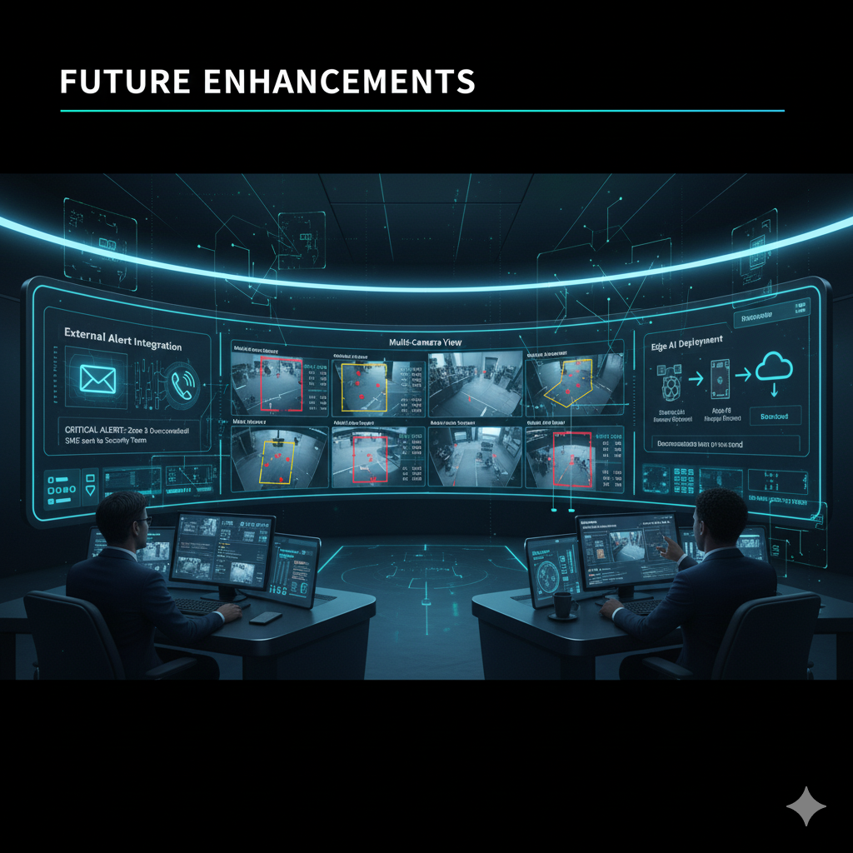
Future Enhancements
Multi-Zone Support: Implement support for multiple configurable zones (e.g., red for danger, yellow for warning) instead of just a single "Red Zone".
External Alert Integration: Integrate with third-party services like Twilio or SendGrid to send automatic SMS or Email alerts to security personnel when a critical threshold is breached.
Cloud Deployment & Multi-Camera View: Re-architect the application for cloud deployment and create a centralized dashboard that can monitor and manage multiple camera feeds simultaneously.
Edge AI Device Compatibility: Optimize the AI model and application to run efficiently on low-power Edge AI devices like the NVIDIA Jetson or Raspberry Pi for decentralized, on-site processing

Slide 22
Conclusion
This project successfully demonstrates a complete AI-Based Crowd Monitoring and Safety Management System, integrating YOLO v8, a robust Flask backend, PostgreSQL database, and a dynamic Chart.js dashboard into a unified, automated solution.
By replacing inefficient manual surveillance, the system delivers:
Real-time person tracking with intelligent Danger Zone detection.
A 3-tier alert mechanism (Per-Person, Zone Population, Overall Population).
A secure, role-based platform featuring an advanced admin panel for live configuration.
Actionable insights through a live dashboard and exportable PDF/CSV reports.
Overall, this project provides a strong foundation for real-world deployments in public safety, retail analytics, event management, and operational monitoring—showcasing how modern AI and web technologies can be combined to build smart, scalable, and responsive safety systems.

Slide 23
Thank You!!!

